Slide 1
Capstone Option 2: Biodiversity for the National Parks
Samuel S. Golant
April 26, 2019
Codeacademy.com

Slide 2
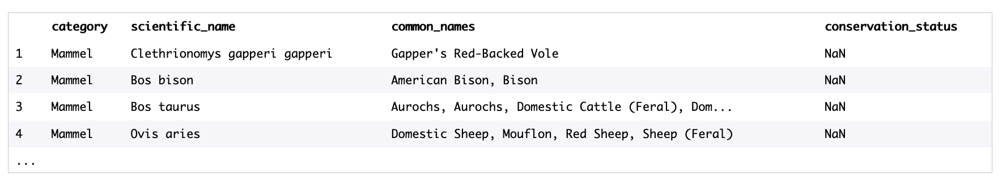
Data analysis on the conservation statuses of species at the National Parks. (Part 1)
A quick examination of the provided species_info.csv file allowed us to see the kind of data collected with the help of the column names:
Since this is just the sample of the data, we need to examine what’s in the table a bit further. With a few python commands we are able to answer the following questions:
How many different species are in the species DataFrame?
The most logical way to do this is to count the unique data values in the scientific_name column. After the calculation, we get 5541.
What are the different values for the category?
To answer this question we will select unique value in the category column. After doing so, we get: ‘Mammal’. 'Bird’, 'Reptile’, 'Amphibian’, 'Fish’, 'Vascular Plant’, 'Nonvascular Plant’.

Slide 3
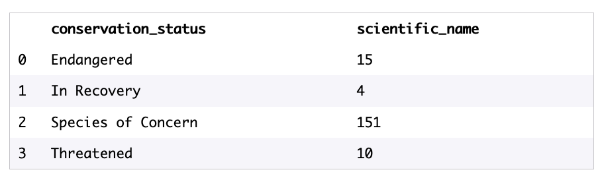

Data analysis on the conservation statuses of species at the National Parks. (Part 1, cont.)
Lets take a look at the different values of conservation_status?
Species of Concern: declining population or appears to be in need of conservation.
Threatened: vulnerable to endangerment in the near future.
Endangered: seriously at risk of extinction.
In Recovery: formerly Endangered, but currently not in danger of extinction throughout all or a significant portion of its inhabitable range.
It would be interesting to know how many of each species fall into these conservation statuses?
Our grouping of the data reveals the following numbers:
But this data does not seem right.

Slide 4
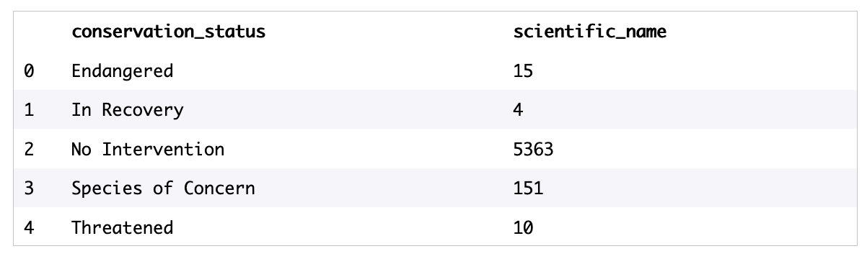
Data analysis on the conservation statuses of species at the National Parks. (Part 1, cont.)
We calculated that the total number of species in the table was 5541. Our grouping only brought back 180. What happened to the rest of species?
After examining the table again we see that our grouping does not include rows where the conservation status is nan. We will need to fill in the null values to get an accurate representation of the species conservation status. Let’s use ‘No Intervention’ value instead of nan. After runnoing our ‘groupby’ command again we get this:
Definitely a better result. And it means that only a small number of species are categorized as needing some sort of protection.
Here’s an example that explains what the table tell us: Under the ‘Endangered’ status, there are total of 15 types of species that fall under one of the categories: ‘Mammal’. 'Bird’, 'Reptile’, 'Amphibian’, 'Fish’, 'Vascular Plant’, 'Nonvascular Plant’..
To help to see it better, let’s take a look at the bar chart that gives us a visual representation of the the above table.

Slide 5
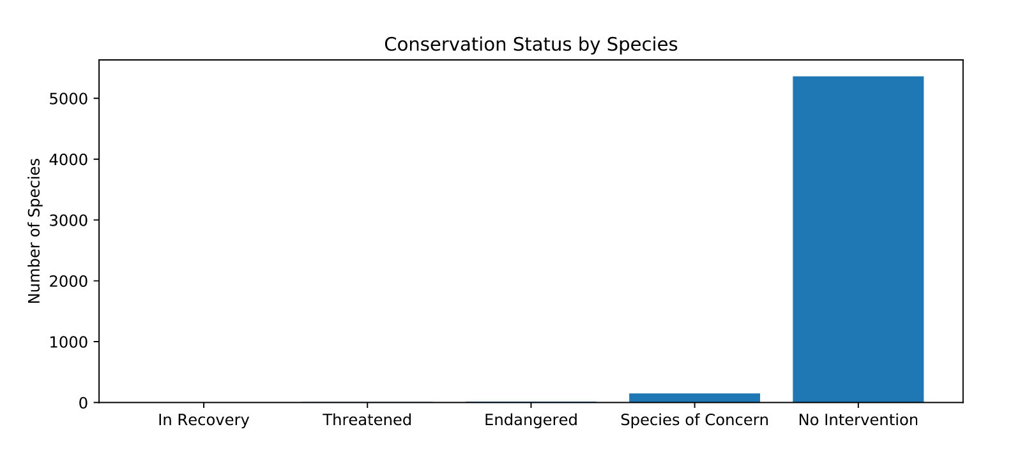
Data analysis on the conservation statuses of species at the National Parks. (Part 1, cont.)

Slide 6
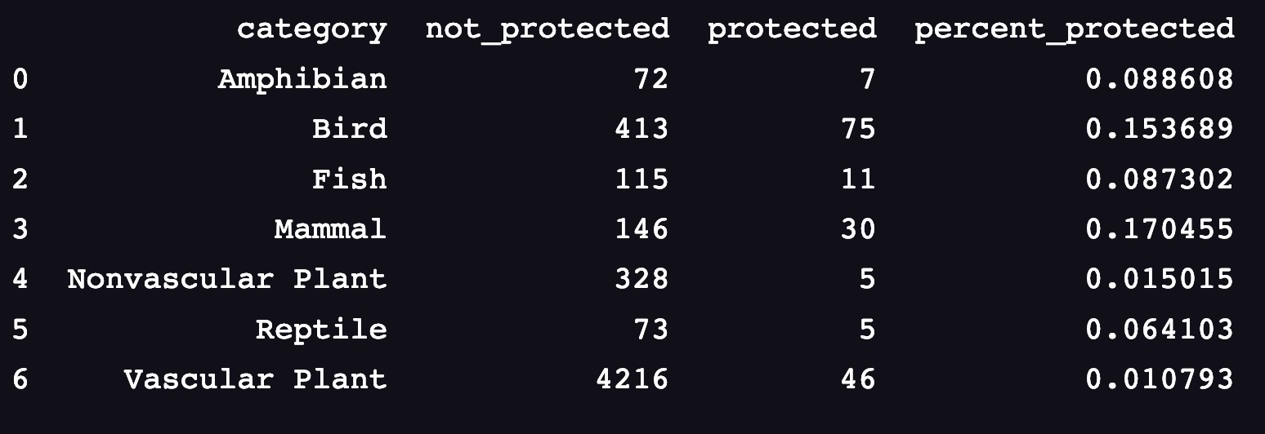
Data analysis on the conservation statuses of species at the National Parks. (Part 1, cont.)
Although the data gave us an idea at the number of species that fall under each conservation status, it does not tell us much about individual species. We still can’t tell if certain types of species are more protected then others and/or more likely to be endangered?
To help us answer this, let’s group and rearrange by the species category and protection statuses.

Slide 7
Data analysis on the conservation statuses of species at the National Parks. (Part 1, cont.)
The table shows us the number of ‘protected’ and ‘non-protected’ per category for each species and gives us a percentage for each. Let’s use ’Mammal’ as an example. Out of 176 (146+30) species of category ‘mammal’, only 30 of those species (about 17%) is under some kind of ‘protected’ status.
To answer the question whether certain category of species is more likely to be endangered then others, and because we are dealing with the categorical data, the chi-squared test is the best fit to run our test analysis.
Let’s us first compare two categories whose ‘percentage_protected’ values are very close. From the table, we see that Mammal and Birds have ~17% and ~15% respectively. Our null hypothesis here is that this difference was a result of chance.
When we ran our chi-squared test, we found a p-value of ~0.688. This value is greater than 0.05, and therefore we can’t reject the null hypothesis and, therefore we can conclude that the difference between the percentages of protected birds and mammals is not significant and is a result of chance.
But, when we compared the percentages of protected Reptiles and Mammals and ran the same chi-squared test, we calculated a p-value of ~0.038, which is less than 0.05 and is significant.
We can conclude that certain types of species are more likely to be endangered than others.

Slide 8
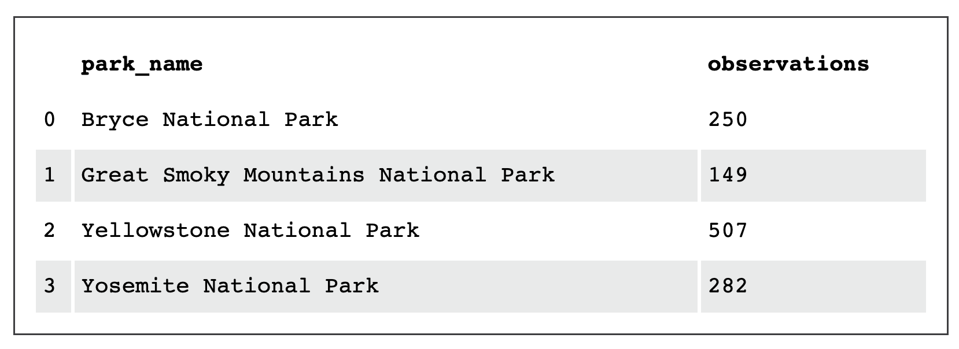
Data analysis for the foot and mouth disease study. In search of sheep… (Part 2)
“A team of ruminant-enthused scientists has been tracking the movements of various species of sheep across different national parks and have asked for your assistance in analyzing the observation and species DataFrames to help track sheep locations.”
After data manipulation, we get the following table representing the total number of sheep observed in each park over the past 7 days.
A bar chart is probably the best fit, if we want the figure to easily show the number of sightings at each of the four National Parks under the observation.

Slide 9
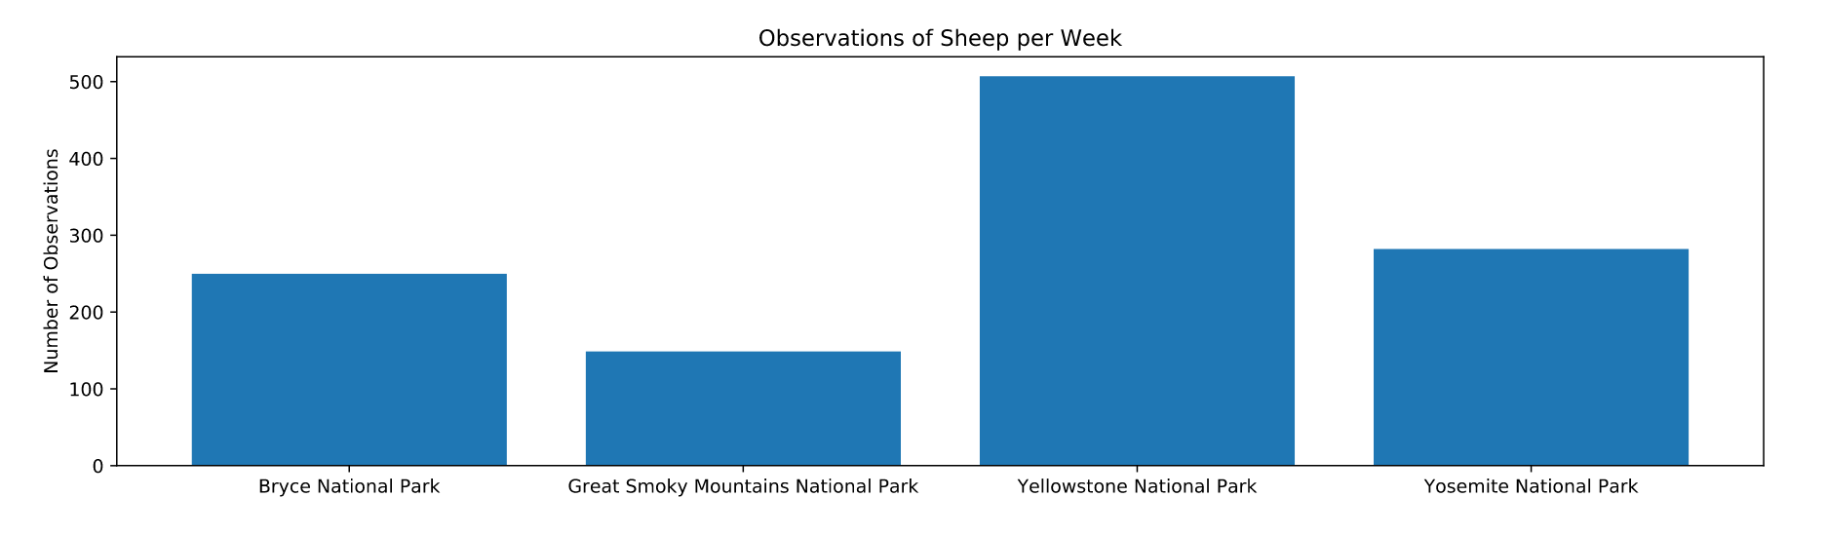
Data analysis for the foot and mouth disease study. In search of sheep… (Part 2, cont.)

Slide 10
Data analysis for the foot and mouth disease study. Foot and Mouth Reduction Effort - Sample Size Determination. (Part 2, cont.)
Park Rangers at Yellowstone National Park have been running a program to reduce the rate of foot and mouth disease at that park. The scientists want to test whether or not this program is working. They want to be able to detect reductions of at least 5 percentage points.
The only information that the scientists currently have is that last year it was recorded that 15% of sheep at Bryce National Park have foot and mouth disease.
OUR GOAL: Using the data above and the sample size, to calculate the number of sheep (sample size) to observe from each park to make sure their foot and mouth percentages are significant. We will use the default level of significance of 90%.
STEPS:
What is the baseline percentage of this sample size determination?
Answer: 15%, based on the given data from Bryce National Park

Slide 11
Data analysis for the foot and mouth disease study. Foot and Mouth Reduction Effort - Sample Size Determination. (Part 2, cont.)
Calculate “Minimum Detectable Effect”.
Answer: If we are trying to detect a 5% change on the baseline of 15%, then the new conversion rate to register as significant, i.e. Minimum Detectable Effect, is calculated based on the following: 5% of 15% is 33.3%. Plugging the numbers into the calculator, we get the needed sample population size required for observation is at least 870.
If we look at the Yellowstone National Park’s existing observations of 507 sheep, it is clear, based on our ”required sample size” that more observations are needed and will require longer period of time. How much time? About a week (870/507).
RESULTS:
Given a baseline of 15% occurrence of foot and mouth disease in sheep at Bryce National Park, if the scientists wanted to be sure that a >5% drop in observed cases of foot and mouth disease in the sheep at Yellowstone was significant they would have to observe at least 870 sheep.
It would take approximately one week of observing in Yellowstone to see that many sheep, or approximately three weeks (870/250) in Bryce National Park to see that many sheep.

